Slide 1
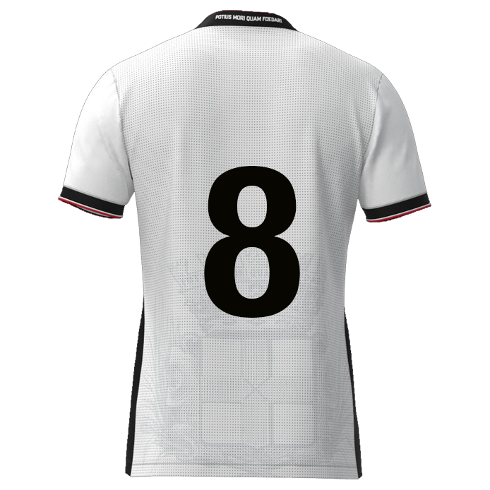

Slide 2

Browse
Foto
DATE: DD-MM-JJJJ
Player name
DD/MM/YYYY: Game / Training
DD/MM/YYYY: Game / Training
DD/MM/YYYY: Game / Training
DD/MM/YYYY: Game / Training
DD/MM/YYYY: Game / Training
DD/MM/YYYY: Game / Training
DD/MM/YYYY: Game / Training
Offensive Passing
xx
xx%
Defensive positioning
Carries
Dribbling past opponent
Offensive positioning
Powerplay
Stamina
Speed
Determination
xxxx
Box-to-box midfielder #08
9
11
7
xxxx
8
10
6
xxxx
xx
xx
xx
xx
5
2
4
3
xxxx
1
xxxx

Slide 3
CB | Rating | Vermenigvuldigingsfactor | Resultaat
Defensive positioning | 0 | 1,1 | 0
Defensive headers | 0 | 1,1 | 0
Passing | 0 | 1 | 0
Carries | 0 | 1 | 0
Power play | 0 | 1,1 | 0
Speed | 0 | 1,1 | 0
Determination | 0 | 1 | 0
 |  | Gemiddelde rating | 0,00

Slide 4
Offensive Passing
Powerplay
Determination
Defensive positioning
Stamina
CARRIES
Dribbling past opponent
Speed
Offensive positioning

Slide 5
Offensive Passing
Defensive positioning
Carries
Dribbling past opponent
“Open play pass <10m (under pressure or through the lines) or open play pass >30m”
“Prevent the direct opponent from finishing, crossing, dribbling or passing by defending well”
“Dribble resulting a duel, after which player remains in possession, resulting in >5m forwards displacement”
'"Dribble with the ball resulting in
>5m forward displacement”
Speed of actions
Type of pass
Both legs
Direction & timing
Pace & height
Preparation
Frequency?
End result
?
Man & ball?
Body position
High or low line?
Danger recognition
Distance lines
Press opponent
Cover passing lines
?
Mobility
Pace & control
Which leg(s)
Covering distance
Space recognition
Frequency
End result
?
Tricks
Power or speed
Inside - outside
Timing
Combination play
Frequency?
End result
?
Offensive positioning
Power play
Stamina
Speed
“Ball receptions in halfspace
and/or final third”
“Attempts by physical strength and forceful challenges to dominate opponents in duels”
“Sustain prolonged effort and maintain performance throughout a match without excessive fatigue”
“Top speed and acceleration capabilities”
Space recognition
Scanning
Awareness
Overload / 3rd man
Reachable
Rotating
Areas of play
?
Strong body part
Groundduels
Aerial duels
Timing
Preparation
Frequency?
End result
?
Intensity
Total distance
HI-runs
Sprints
Maintaining 90 mins
Average mins p/g
?
Top speed
Acceleration
Stride length
Big / small distance
First meters
End result
?

Slide 6
Determination
“Showing strong will, persistence, and commitment to succeed, even in difficult situations”
Emotion control
Behaviour (by result)
Mourning
Inspiring others
Never give up
Fight until the end
Always 100%
?

Slide 7



Slide 9
Carries

